Slide 1
Web Accessibility and SEO at the CFPB
Andy Chosak, Sonna Kim, and Callan Pyfer
April 28, 2022

Slide 2
Disclaimer
This presentation is being made by a Consumer Financial Protection Bureau representative on behalf of the Bureau. It does not constitute legal interpretation, guidance, or advice of the Consumer Financial Protection Bureau. Any opinions or views stated by the presenter are the presenter’s own and may not represent the Bureau’s views.

Slide 3
Agenda
The CFPB and our website
Ensuring website accessibility
Ensuring website discoverability (SEO)

Slide 4
The CFPB and our website
4

Slide 5
The Consumer Financial Protection Bureau
The Consumer Financial Protection Bureau (CFPB) is a U.S. government agency created after the 2008 financial crisis.
We aim to make consumer financial markets work for consumers, responsible providers, and the economy as a whole.

Slide 6
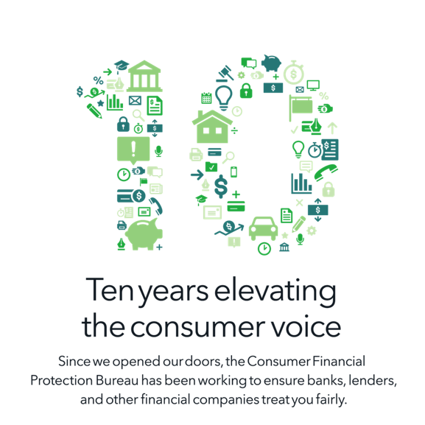
Celebrating 10+ years of consumer protection
$14.4 billion
Approximate amount of relief to consumers from CFPB supervisory and enforcement work
7.3 million
Consumers accessed COVID-specific education content since the beginning of the pandemic
3.1 million
Consumer complaints handled by the CFPB
Figures current as of June 30, 2021.

Slide 7
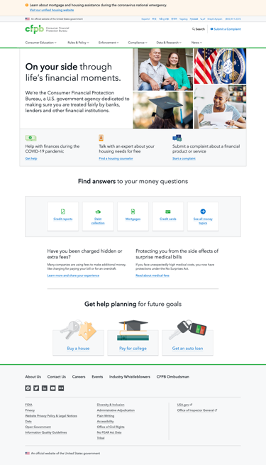
The CFPB website
https://www.consumerfinance.gov
Serves a large, diverse audience
8,000+ pages, 2.6 million visits / month
Multiple audiences
Multiple languages
Multiple devices
Visits data from analytics.usa.gov, 30 days ending 4/6/2022.

Slide 8
The CFPB website: Diversity of content
Educational guides
Interactive tools
Regulatory and legal text
Research databases
Press releases and blog posts
And more!

Slide 9
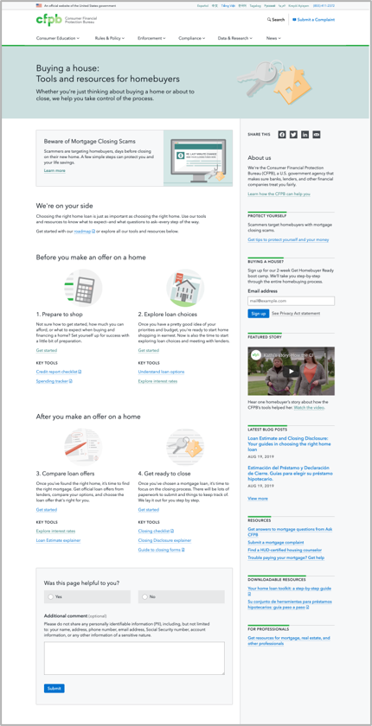
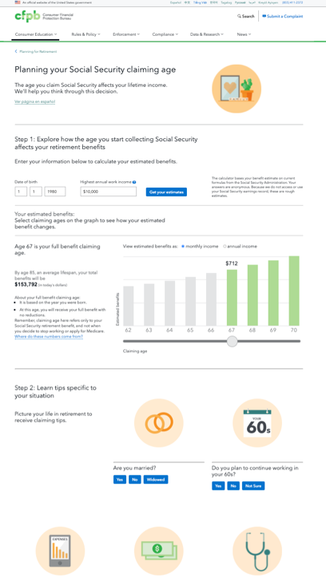
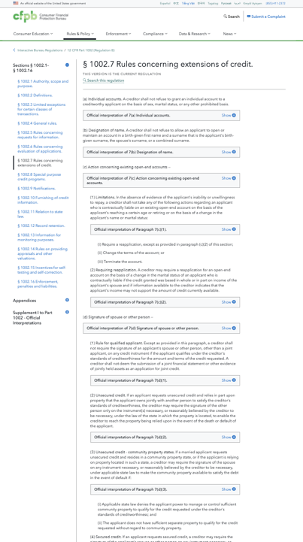
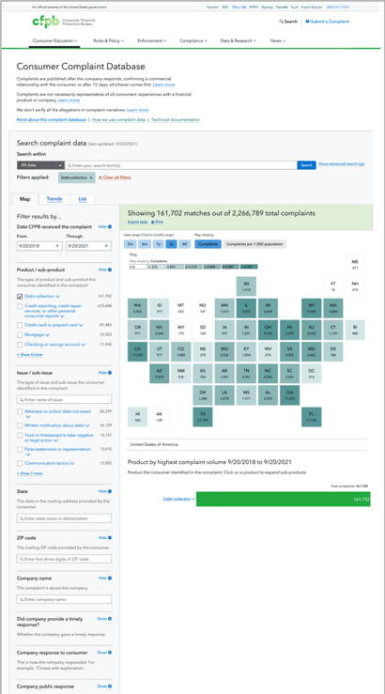
Selected screenshots demonstrating diversity of content

Slide 10
Ensuring website accessibility
10

Slide 11
Ensuring accessibility for all
People with visual impairments
People who are deaf or hearing impaired
People with physical impairments
People with cognitive, learning, or neurological impairments

Slide 12
CFPB’s accessibility responsibilities
Section 508 of the Rehabilitation Act of 1973
Federal agencies must ensure all electronic and information technology is accessible to individuals with disabilities
Web Content Accessibility Guidelines (WCAG)
Conformance levels (A, AA, AAA)
Revised Section 508 Standards (2018)
All electronic content shall conform to the Level AA standard of WCAG 2.0
(Legal requirements aside, accessibility is also important for SEO!)

Slide 13
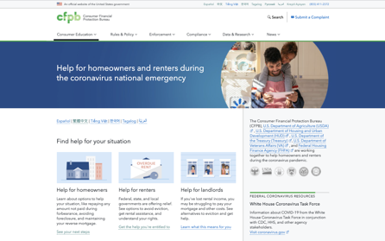
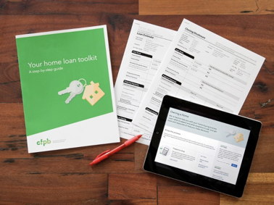
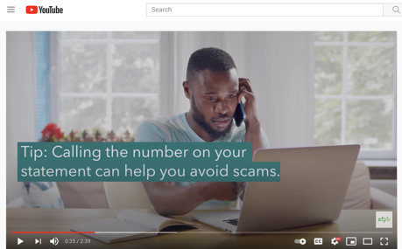
Ensuring accessibility in our work
Our team includes user experience designers, graphic and production designers, content strategists, and web developers
Work encompasses web design and development, print design, and multimedia

Slide 14

Accessibility at the CFPB
Produce accessible web and print products
Audit and remediate the accessibility of products produced

Slide 15
Four strategies for web accessibility
CFPB Design System
Manual accessibility audit
Automated accessibility testing
Qualitative testing with users of assistive technologies

Slide 16
Four strategies for web accessibility (1)
CFPB Design System
Manual accessibility audit
Automated accessibility testing
Qualitative testing with users of assistive technologies

Slide 17
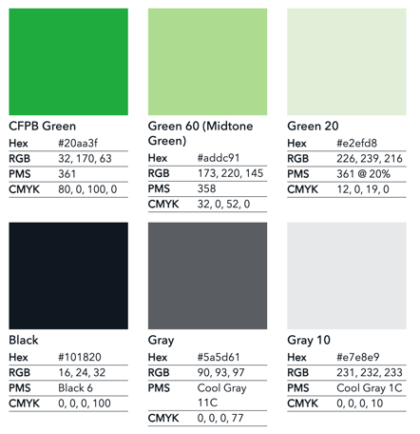
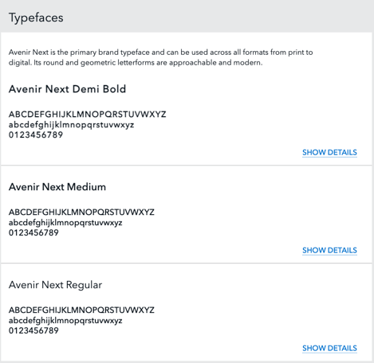
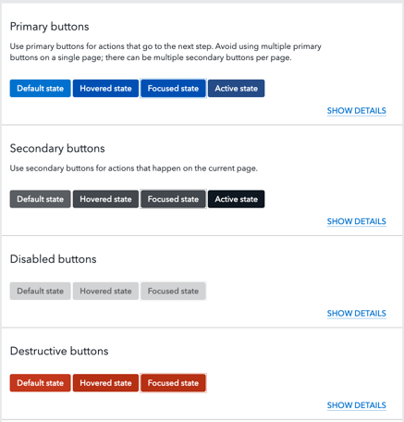
What is a design system?
A design system is a set of reusable components that supports creating consistent, accessible designs at scale.

Slide 18
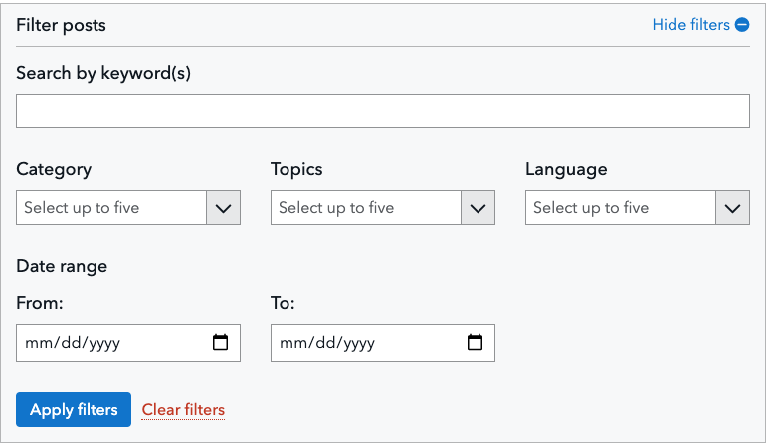
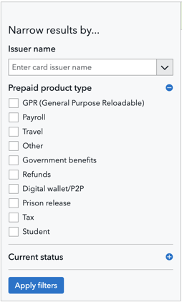
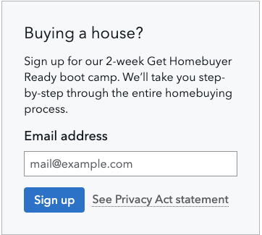
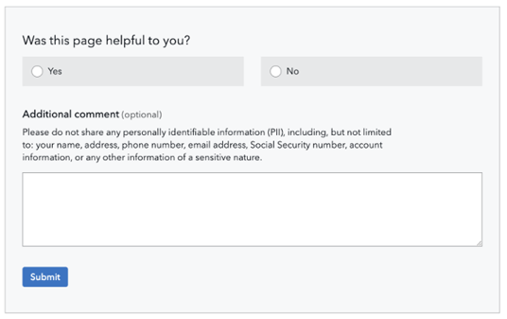
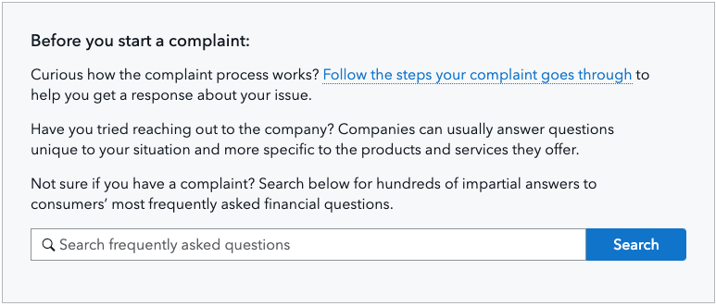
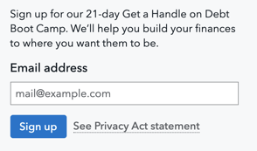
Smaller components combine to form larger patterns

Slide 19
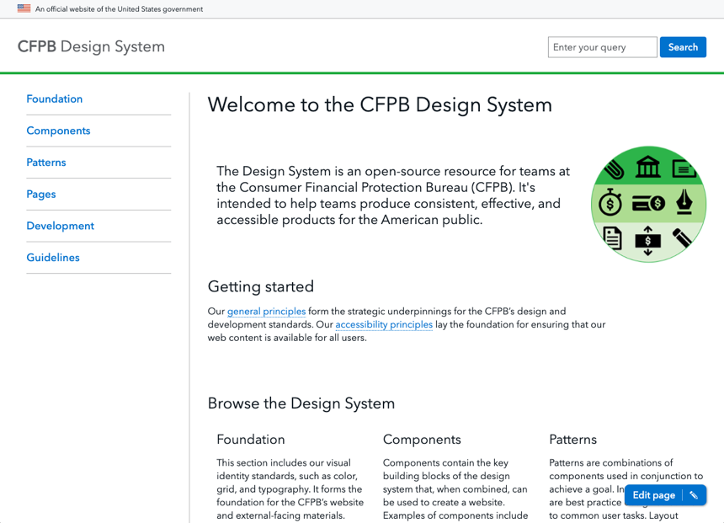
The CFPB Design System
https://cfpb.github.io/design-system/

Slide 20
Design System sections
The foundation section includes our visual identity standards, such as color, grid, and typography.
Components are our individual elements that can be used to create a web page.
Patterns are combinations of components used in conjunction to achieve a goal.
Also includes general and component-specific accessibility guidelines.

Slide 21
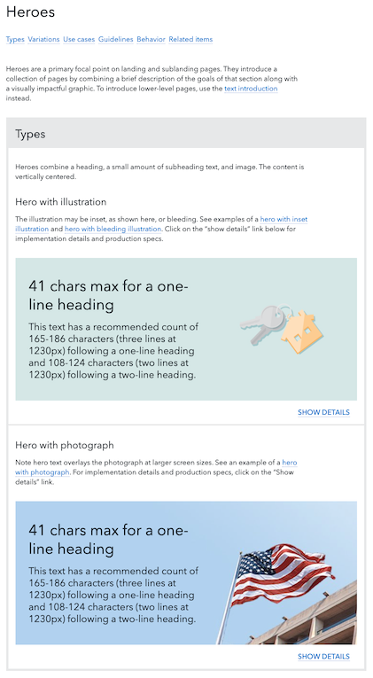
Design system example: Hero pattern

Slide 22
Using the CFPB Design System in our work
Designs, code, and documentation all in one place
Open source: https://github.com/cfpb/design-system
Includes integrations for web developers
Published as an NPM package
Wagtail CMS integration

Slide 23
Four strategies for web accessibility (2)
CFPB Design System
Manual accessibility audit
Automated accessibility testing
Qualitative testing with users of assistive technologies

Slide 24
Manual accessibility testing at the CFPB
Comprehensive process to catch accessibility bugs
Builds empathy, awareness, and greater understanding
Builds knowledge that can be applied to design and development

Slide 25
The CFPB manual accessibility audit
Based on WCAG 2.0 AA standards (with some AAA and WCAG 2.1 criteria added)
Designed to be easy to use for web designers, developers, and others
Editable spreadsheet
Written for use on MacBooks and iPhones
Covers:
HTML validation & some automated checks
Voiceover testing
Keyboard testing
Mobile testing
Sensory-sensitive & forms testing

Slide 26

How the manual audit is run
Find a spot on the floor
Open the manual audit spreadsheet
Open the page that's being tested, on either desktop or mobile
Run and rate each step
Perform additional steps to calculate bug severity
26

Slide 27
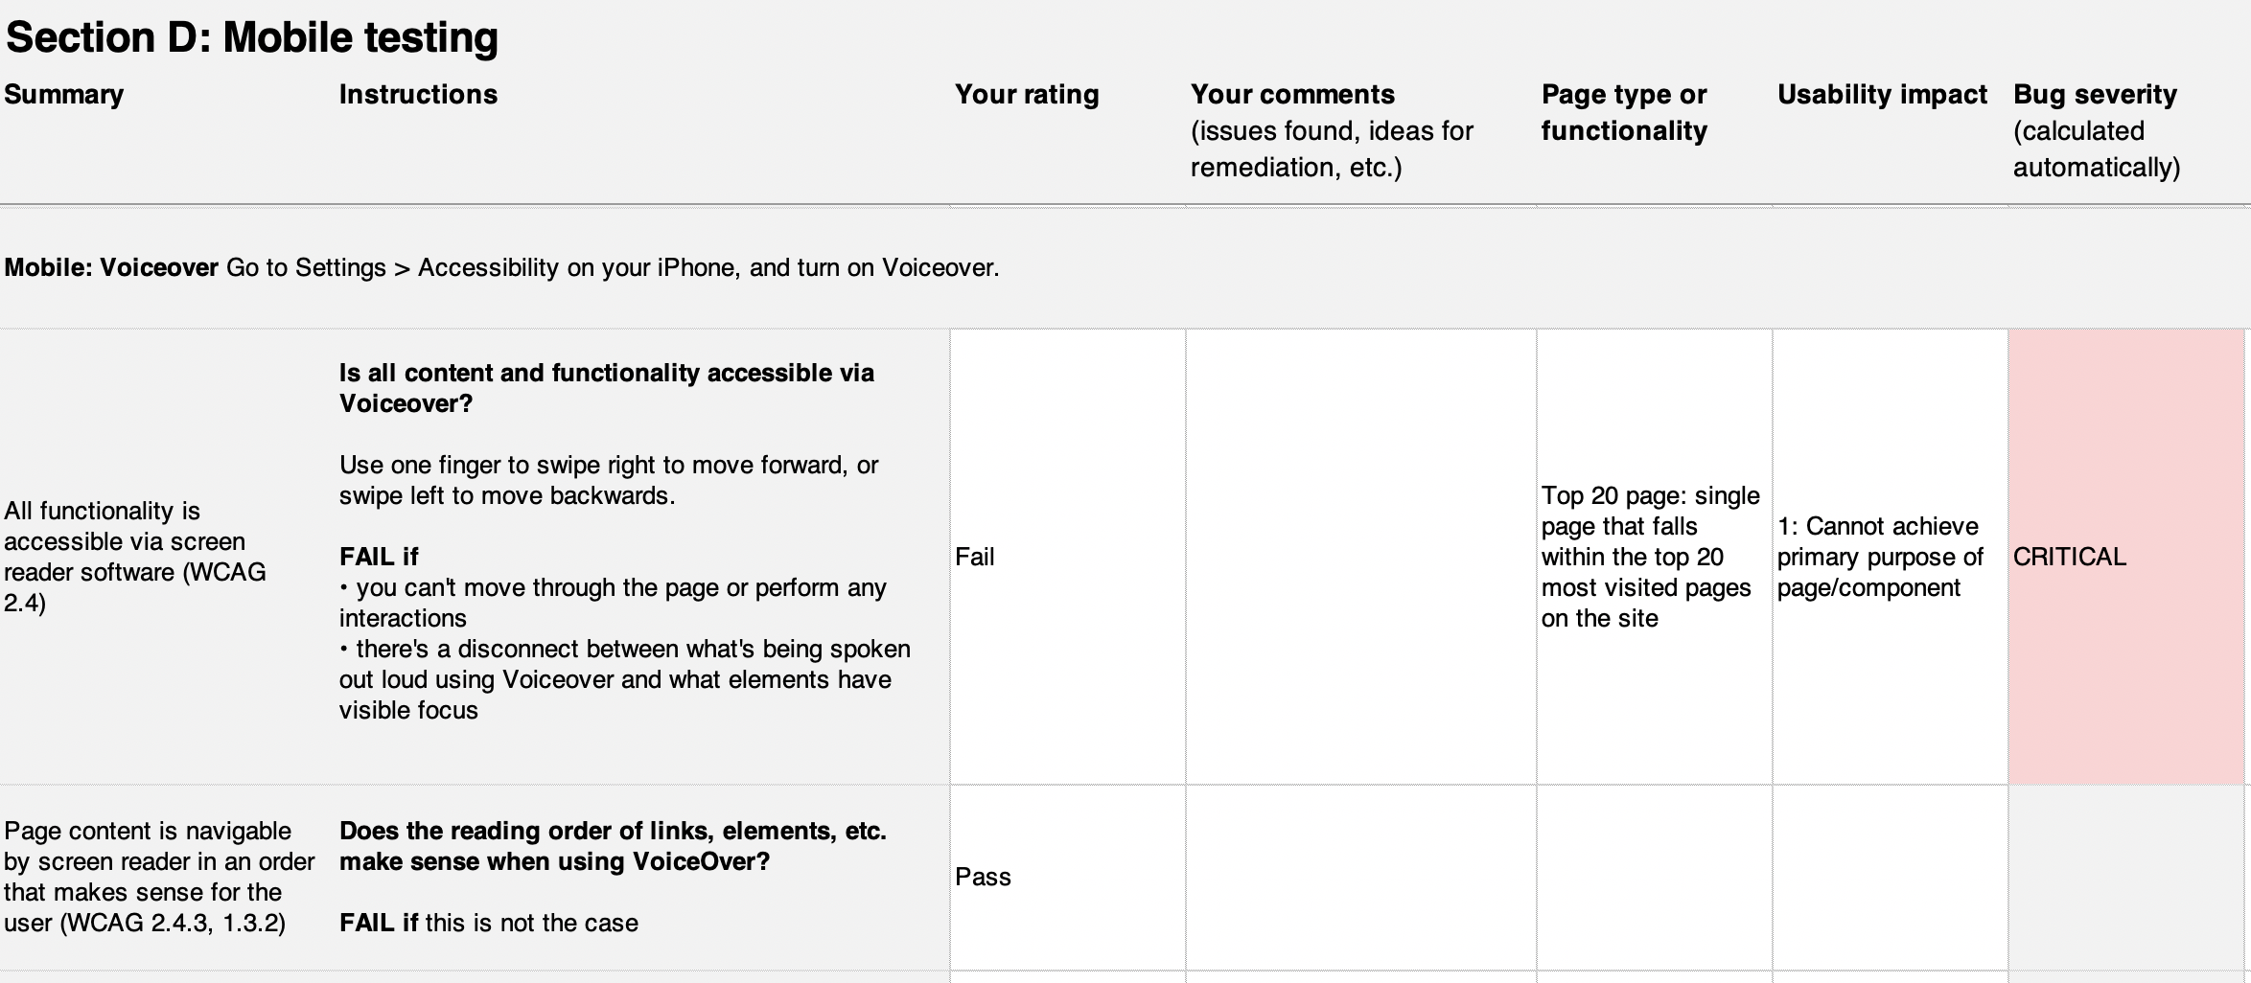
Screenshot of the manual audit: Mobile testing

Slide 28
Using the manual accessibility audit in our work
When we use the manual audit
When components or patterns are created or modified
Before new products are launched
As part of regular periodic testing
The manual audit is freely available for download and use by the public as part of the CFPB Design System:
https://cfpb.github.io/design-system/guidelines/accessibility-audit-tools

Slide 29
Four strategies for web accessibility (3)
CFPB Design System
Manual accessibility audit
Automated accessibility testing
Qualitative testing with users of assistive technologies

Slide 30
Automated accessibility testing at the CFPB
Manual audit is thorough, but doesn’t scale well
(1 hour+ for a person to fully audit a page) x (8,000+ pages on the CFPB website)
Some steps in the manual audit can be run automatically by software
Results are less comprehensive, but still valuable
Goal: Regularly check our pages for accessibility issues using automated tools
Leverage free automated accessibility testing tools
Configure testing to run periodically against our website
Collect test results in one place for easy review

Slide 31
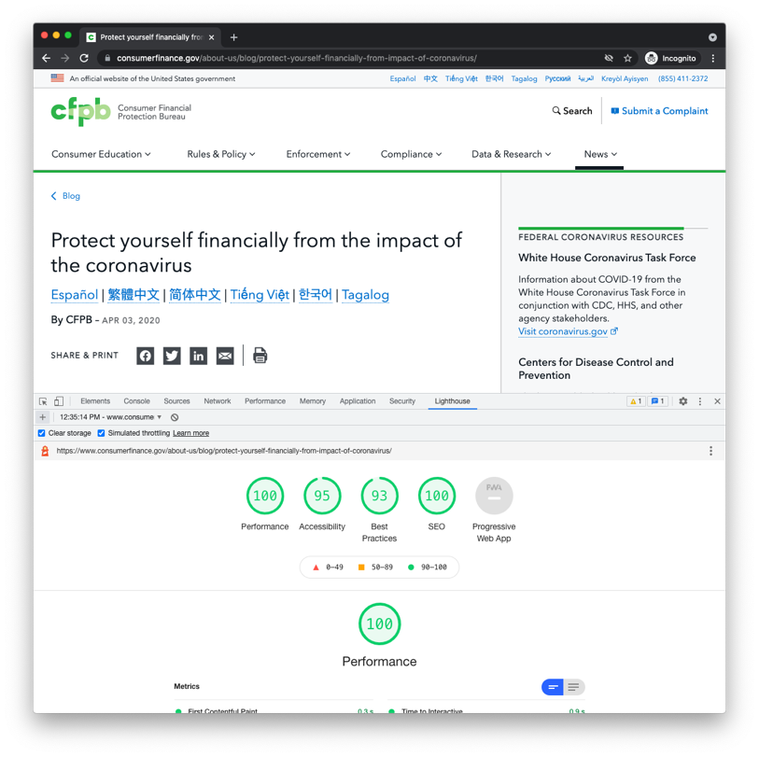
Running Lighthouse against a single web page
Open the URL to be tested in Google Chrome
Open Chrome DevTools
Click the Lighthouse tab
Click “Generate report”
After 30 to 60 seconds, Lighthouse gives you a report on the page

Slide 32
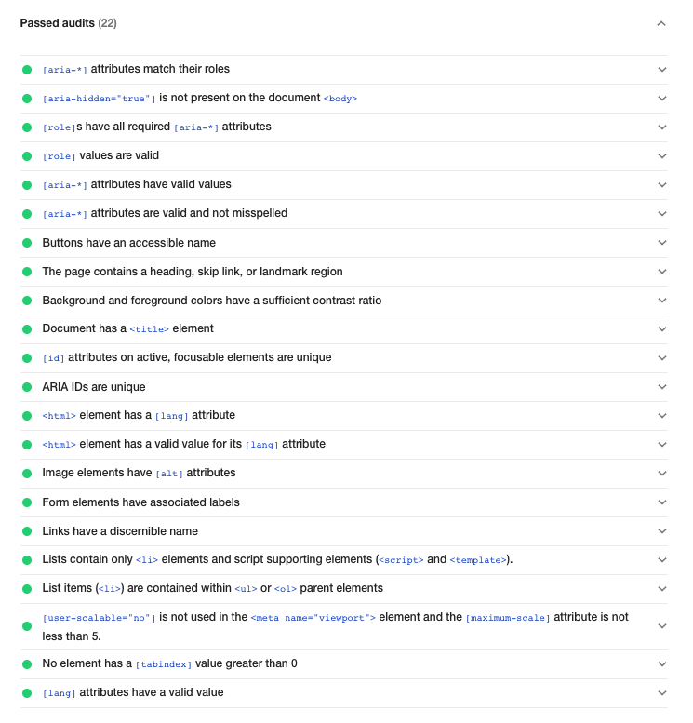
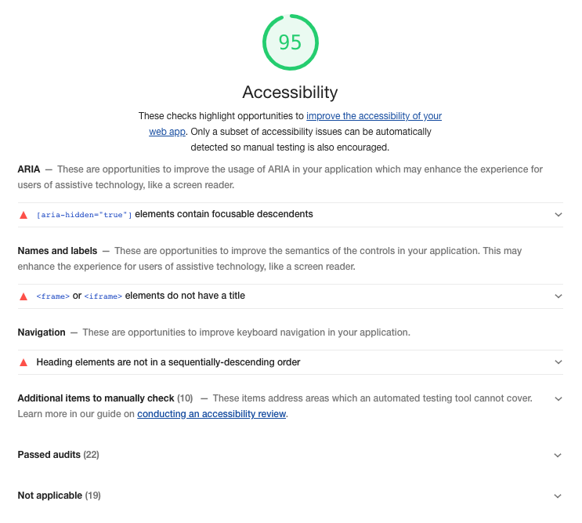
Google Lighthouse accessibility results

Slide 33
Running Lighthouse against multiple pages
Choose which web pages to audit
Popular, high-profile, recently changed
Configure nightly process to run Lighthouse tests automatically
Create user-friendly dashboard to review testing results

Slide 34
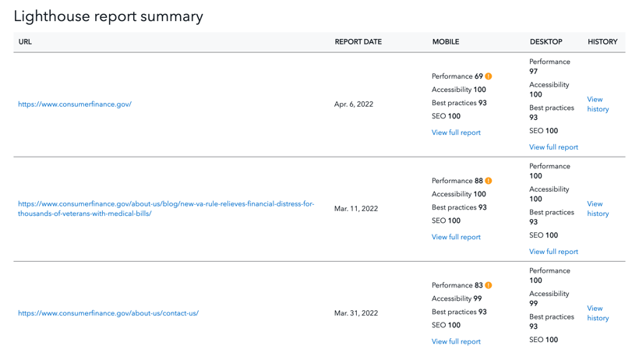
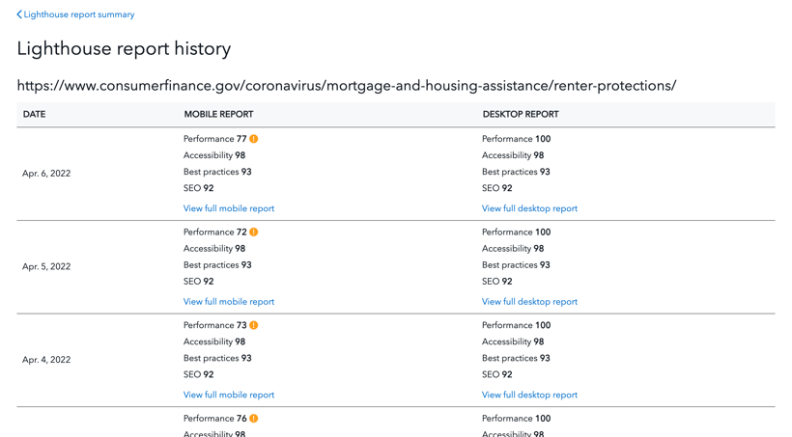
Lighthouse testing dashboard
https://cfpb.github.io/cfgov-lighthouse/
Landing page: list of URLs with latest scores
URL history view

Slide 35
Using automated accessibility testing in our work
Dashboard is kept up-to-date with most relevant website pages
Teams regularly review testing results to identify and fix issues
Open source: https://github.com/cfpb/cfgov-lighthouse

Slide 36
Four strategies for web accessibility (4)
CFPB Design System
Manual accessibility audit
Automated accessibility testing
Qualitative testing with users of assistive technologies

Slide 37
Usability testing pilot with users of assistive technologies
Why: Direct feedback from users is important
What issues people are experiencing, which need to be prioritized
Pilot (March 2022)
Conducted remote testing with two blind/low vision participants
Validated the accessibility of our site; some minor fixes
Gained a better understanding of logistics
Next step: Expand testing more widely across the Bureau

Slide 38
Ensuring website discoverability (SEO)
38

Slide 39
What is SEO?
Search Engine Optimization is the process of increasing organic visibility when people search for related queries to your business in Google, Bing, DuckDuckGo, and other search engines.

Slide 40
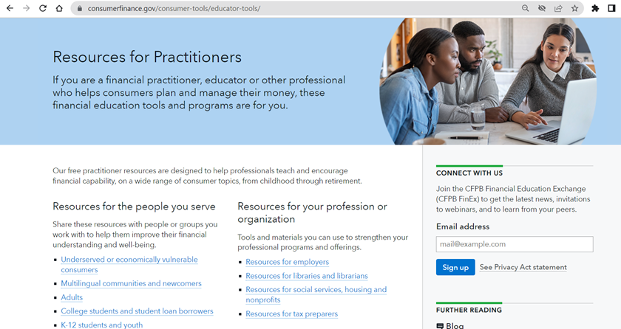
The Role of Optimized Content
The content should begin with a general overview of the topic and get more granular as the content progresses.
Keywords should be utilized in the Headings and throughout the copy of the page.

Slide 41
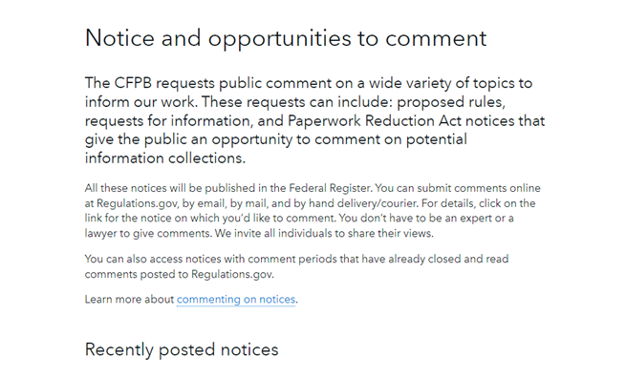
Internal Linking
Internal links to relevant content should be placed naturally throughout the text using optimized anchor text.
Linking pages on your site to each other establishes authority across your site.
Internal linking is most useful for establishing site architecture and spreading authority throughout the website to important pages.

Slide 42
URL Structure
URLs helps signal to search engines what each page is about.
The structure of URLs are important for both users and search engine crawlers.
The more readable URLs are to users, the more authority the search engine crawlers will assign to that content.

Slide 43
Importance of Human-Readable URLs
Accessibility and user experience are critical towards achieving organic visibility for queries where searchers have the correct intent.
Human-readable URLs perform better than those without because users trust the content.
Example:
https://www.consumerfinance.gov/askcfpb/202/ vs
https://www.consumerfinance.gov/ask-cfpb/should-i-consolidate-refinance-student-loans-en-561/

Slide 44
Using Hyphens Rather Than Underscores in URL Structure
Google treats a hyphen as a word separator, but does not treat an underscore that way.
Google treats an underscore as a word joiner.
Example:
shoes/red_sneakers/ reads the same as redsneakers to Google.

Slide 45
Inclusion of Keywords
The inclusion of industry-relevant keywords in the URL provides the page with more authority, which increases the likelihood that the content will show up in the Search Engine Results Pages (SERPs) that your target market is actively searching for.
Keywords are one of the most prominent elements searchers consider when selecting a site to click.

Slide 46
Importance of Logical Folder Structure
Folders create a perception of site depth for search engines and users.
The higher the page is in the folder system the more valuable the page appears to search engines.
Example:
https://www.consumerfinance.gov/compliance/supervision-examinations/homeowners-protection-act-hpa-or-pmi-cancellation-act-examination-procedures/

Slide 47
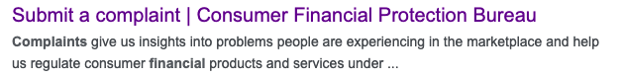
Metadata
Metadata is the data that appears on Google’s Search Engine Results Page (SERP).
Title tags are among the most important on page ranking factors as well as an important place to include target keywords.
Meta descriptions are not a direct ranking factor like title tags, but do help improve organic click through rates.
A title tag is an HTML element that specifies the title of a web page. A page’s title tag is displayed in the SERP. It appears as the clickable headline for the search result and is important for not only SEO but also user experience and social sharing.
Google pulls directly from the website if there is no optimized meta description in place. This causes the content to be truncated & no CTA is included.

Slide 48

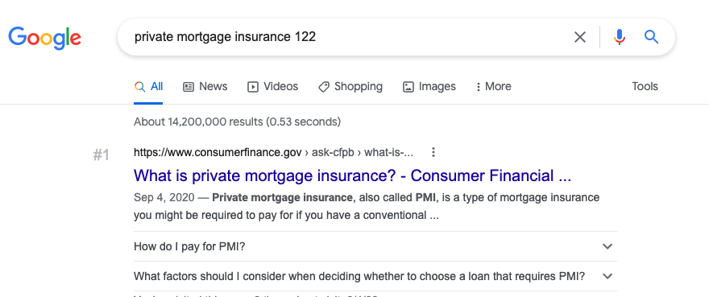
Structured Data and Google Rich Snippets
Structured data, also known as schema markup, is a type of code that is applied to make it easier for search engines to read your website.
Structured Data helps websites provide the information that search engines need to understand, and improves the way your page displays in the search results.
Example of FAQ Schema deployed via Google Search Console
Example of inlinks in SERP listing as well as other SERP elements such as “People Also Ask” as a result of deploying FAQ schema on consumerfinance.gov.

Slide 49
SEO and Accessibility
Google has been awarding more authority towards sites with strong user accessibility over the last decade.
Accessibility metrics include:
Alt Text for all images
Proper metadata on all pages
Clear Page Titles
Human-readable URLs
Descriptive Links
Breadcrumbs
Transcripts and text captions on all multimedia content
Inclusion of HTML sitemap

Slide 50
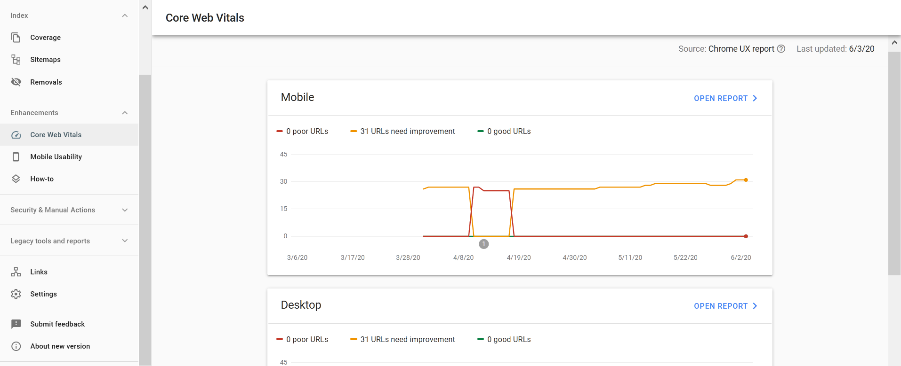
Core Web Vitals Update
Largest Contentful Paint (LCP)
Marks the point in the page load timeline when the page’s main content has likely loaded
First Input Delay
Measures responsiveness and quantifies the experience users feel when trying to first interact with the page
Cumulative Layout Shift (CLS)
Measures visual stability and quantifies the amount of unexpected shift of visible page content
In June 2021, Google updated their algorithm, placing an increased emphasis on page speed metrics as a ranking factor.

Slide 51
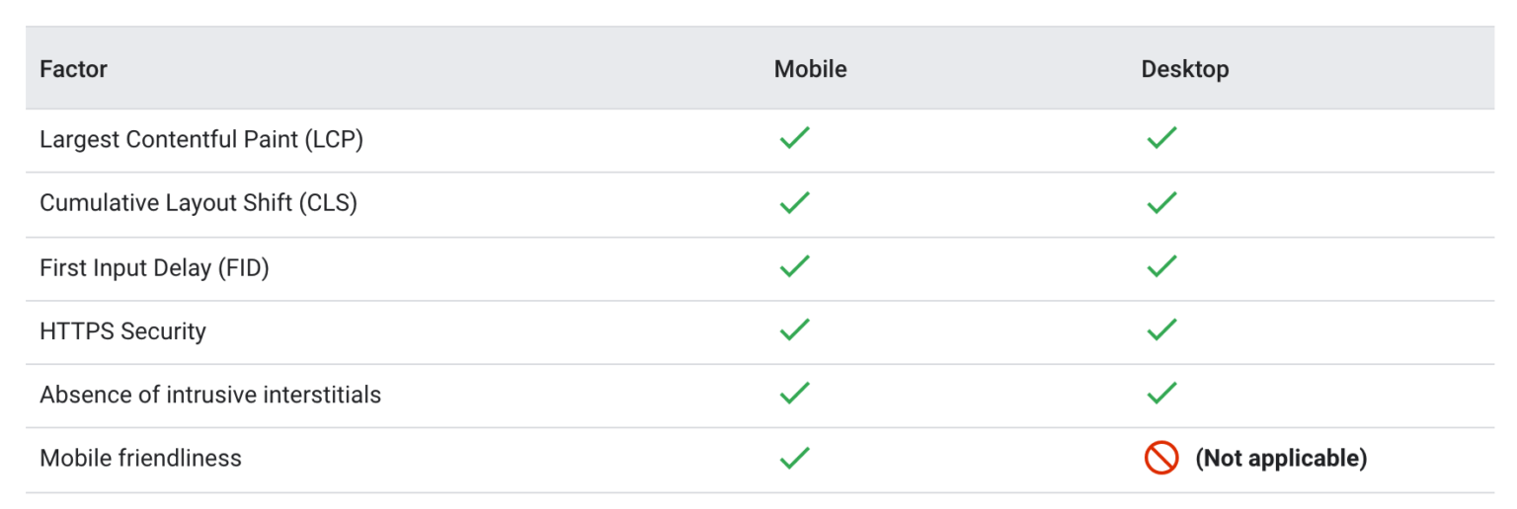
2021 Algorithm Updates

Slide 52
March 2022 Google Algorithm Update
On March 23, 2022 Google updated their search engine ranking algorithm to promote “"insightful analysis and original research" on product reviews.
While this is not a Core Update, it is critical to be mindful of algorithm changes such as the product reviews update, to best optimize your content.
Any content with ranked lists and comparison reviews should be relatively concise to not overwhelm the user.

Slide 53
Thank you!
Our website: https://www.consumerfinance.gov
CFPB Design System: https://cfpb.github.io/design-system/
Manual accessibility audit: https://cfpb.github.io/design-system/guidelines/accessibility-audit-tools
Lighthouse dashboard: https://cfpb.github.io/cfgov-lighthouse/
andy.chosak@cfpb.gov
sonna.kim@cfpb.gov
callan.pyfer@cfpb.gov

